Slide 1

Census 2020:
Research and Messaging
September 12, 2018
Presented by
Arturo Vargas
Chief Executive Officer
NALEO Educational Fund

Slide 2

To test key ideas:
Interest/awareness of the Census Empowerment/resistance messages
Understanding of convenience/compliance Understanding of community benefit
To identify concerns about Census participation across response formats
(online, in-person, paper, phone)
To identify trusted messengers, especially on traditional media and social media platforms
To determine messages that move people to action
To test behavioral outcomes, not just attitudes
To increase understanding of the Hard-to-Count Latino community
To complement research conducted by the Census Bureau and other organizations
RESEARCH AND
MESSAGING GOALS

Slide 3

RESEARCH METHODOLOGY
With Latino Decisions, NALEO Educational Fund Conducted:
NATIONAL POLL
Nationally representative sample of the adult Latino population (Surveyed 1,600 Latinos between April 11-20, 2018)
Participants were assigned to four treatment groups and a control group to test message
FOUR FOCUS GROUPS
Messages from the survey experiment were tested to evaluate what refinements are needed, given local and demographic nuances (Conducted May 8 in Charlotte, North Carolina and May 9 in Rio Grande Valley, Texas)
40 participants in two locations:
  Each location had an English group and a Spanish group
  All scientifically-selected participants knew people who are not citizens; they described the mixed status nature of their local communities.
  29 were U.S. citizens
  11 were not U.S. citizens
  31 had both parents born outside the United States
  Only five (all in the Rio Grande Valley) had both parents born in the United States

Slide 4

GENERAL VIEWS ON CENSUS
Participants had a generally positive view of the Census.
Hesitation, fear, and cynicism arose among focus group participants when they saw a version of the actual questionnaire
  The citizenship question raised the most concerns, anxiety increased as participants considered the reality of providing their information to the current administration
There was lack of confidence that the data provided would be kept confidential.
“You know in Spanish the word, ‘desconfianza’? Ok that’s how I feel about it… …So, for me personally, this gives me that “desconfianza” feeling, asking about citizenship. I don’t think this Census is going to be very effective.”

Slide 5
VIEWS ON RESPONSE MODES
Survey respondents overwhelmingly expressed a preference to complete the Census by mail on a paper form (75 percent)
Nearly 40 percent of respondents said it is not convenient to complete the form online
  “There's people that don't have internet service down here in the Valley [Texas], some areas just don’t have it.”
  “My mom is 61 years old and she’s not going to go on the computer. She’ll think it’s a trick, won’t like it, and won’t fill it out. If I go help her out, yes, she’ll do it. They are going to lose people who aren’t comfortable online.”
Over 64 percent of respondents said that sending a Census worker to their home was not convenient

Slide 6

2020 CENSUS MESSAGES
Any message is better than none: all four messages tested - Convenient, Safe, Required; Civic/Community Duty; Funding; Resistance/Defend Community - performed better than the control group which received no message
Messages about Census participation being “Convenient, Safe and Required” showed the most positive response in the survey
“Participating in the Census is safe and really easy, just a few clicks online. The Census protects your personal data and keeps your identity anonymous. By federal law, your response is required, and your information cannot be given out or shared”
Messages about the role of Census data in providing funding for local schools and community programs were the most effective in the focus groups
“The government relies on the Census population count to determine funding for state and local services, including education, police, fire, and health care. Our community schools, hospitals, and first responders are depending on us to do our part and participate in the Census”

Slide 7
2020 CENSUS MESSAGES (continued)
Subgroup differences of note on the survey experiment
Immigrants were especially responsive to the convenience, safety, and required message with 75 percent saying they would definitely participate in response to the message. This is consistent with the serious privacy concerns voiced in the study
Women were most responsive to the civic and community duty message with 57 percent saying they would definitely participate in response to the message
Latinos under age 40 were most responsive to the resistance message, with 53 percent saying they would definitely participate in response to the message

Slide 8
2020 CENSUS MESSENGERS
MESSENGERS
Consistent with previous NALEO voter engagement research, “Family Members” were the most trusted messengers
  Our previous voter engagement research also suggested that women in the household, in particular, were effective messengers
Nurses, doctors, health providers and Latino community organizations were also highly trusted as messengers
People who speak for “the children” or “the schools” – such as teachers -- were especially trusted and convincing (our previous research on voter engagement had comparable findings)
Elected officials were among the least trusted as a reliable source for information

Slide 9

2020 CENSUS:
NEWS AND INFORMATION SOURCES
AND PLATFORMS
For Spanish-speakers, Spanish-language media were trusted source of information
Younger participants had more favorable views of social media as a source of information
85 percent of survey participants were regularly (daily) online via smartphones (less than half said they used a laptop or desktop computer on a daily basis)
Survey participants frequently search online to get more information or verify what they have heard on social media or the news
Email and Facebook were the most frequently used (daily basis)
Twitter was the least frequently used (more than half said they used it on a monthly basis or rarely/never)

Slide 10

2020 CENSUS: LOCAL CONTEXT
Local context must be considered in Census planning, outreach and implementation. Focus groups in Charlotte referenced the December 2017 countywide data hack in discussing Census data security
Participants in all four focus groups discussed increased immigration enforcement, and traffic stops for minor infractions that have made people fearful about interactions with law enforcement and government
  “Last week they stopped my cousin because he didn't have a blinker and he didn't have papers. So, just because of the blinker, the cop called immigration. So, I know if my tia or anybody in the family read this [Census form], they wouldn’t fill it out. They'll be scared.”

Slide 11

2020 CENSUS:
UNDERCOUNT OF CHILDREN
Households with children age seventeen and younger
53 percent of survey respondents stated that they have one or more children age seventeen and younger in the household
Among respondents with children age seventeen and younger in the home, 11 percent said they would not count them or do not know if they would
Households with children age four and younger
24 percent of survey respondents stated that they have one or more children age four and younger in the household
Among respondents with children age 4 and younger in the home, 15 percent said they would not count them or do not know if they would
More research is needed to assess these attitudes toward excluding children in the household from the Census

Slide 12

NALEO Educational Fund Independent Assessment of the End-to-End Test
SURVEY of representative sample of Providence County residents
INTERVIEWS with elected officials and community leaders
REPORT due in October will hopefully help stakeholders:
Inform plans for Census 2020 outreach and GOTC efforts
Understand participant concerns about confidentiality and attitudes about the citizenship question
OUR PARTNERS are Dr. Kevin Escudero, Assistant Professor of American Studies and Ethnic Studies at Brown University, and Gabriela Domenzain, Executive Director of Latino Policy Institute at Roger Williams University
GCPI has published its first fact sheet on the test, covering its scope, purpose, design, and timeline; other fact sheets will cover the resulting technological and operational concerns the Bureau must address

Slide 13

2010 Census Campaign – Responding to the Moment

Slide 14
2010 Census Campaign

Slide 15

RESEARCH RESULTS APPLICATION
SOCIAL MEDIA ADVERTISING STRATEGY - 2018
Branded social media campaign targeting Latino millennials (18-35) and Spanish-language speakers 35 years-old and older
Utilizing tailored messages based on research results
Unique hashtags that partners can amplify
Testing of effective messengers from focus groups and research
Implementing a comprehensive media outreach and advertising plan that will educate the Latino community about the importance of Census 2020

Slide 16
RESEARCH RESULTS APPLICATION
SOCIAL MEDIA COMPONENTS – 2018
Animated Video
  90-second animated educational video on the Census that will be promoted through digital platforms
  Posted on NALEO Educational Fund social media accounts to maximize views through targeted Facebook advertising
  Production September 19 – October 17 with a launch in late October
Educational Message
  Social media graphics that present easily-digestible facts (“stuff you should know”)
  Promoted on Facebook and Instagram for maximum reach
  Launch in early October

Slide 17
RESEARCH RESULTS APPLICATION
SOCIAL MEDIA COMPONENTS – 2018
Interactive graphics
  Reach members of community where they are - Create graphics that are similar to the “choose your journey” questionnaires that have been popularized by online sites such as BuzzFeed
  Illustrate impact of not participating in the Census - Create graphics inspired by the “what’s missing in this photo?” images allowing online users to examine differences illustrating the impact of not participating in the Census
  Launch in mid- November 2018
“RSVP for Census 2020”
  Using existing research that Latinos are more likely to participate if they are directly contacted or invited, an “RSVP for Census 2020” campaign will be launched
  An image and link to an “I RSVP” web portal will be created to provide users an opportunity to act by pledging to participate in Census 2020
  Launch December 3

Slide 18
RESEARCH RESULTS APPLICATION
TRADITIONAL MEDIA PARTNERSHIPS AND ADVERTISING STRATEGIES - 2018
TV and Radio
  Develop outreach strategies with national Spanish-language media partners, including Univision, Telemundo, and Impremedia
  Promote national and local radio media Census-related stories to educate the community on the importance of an accurate count
  Targeted partnership strategy slated for mid-November
Pandora
  Target Latino Spanish speakers 35-and-above in the Rio Grande Valley (Texas), Central Valley (Calif.), Charlotte (NC), and Miami-Osceola (Fla.) through Spanish-language ads
  Include action link directing individuals to “RSVP for Census 2020” through NALEO Educational Fund website
  Collect basic contact information to continue to engage leading up to Census 2020
  Launch date for ads is December 1

Slide 19
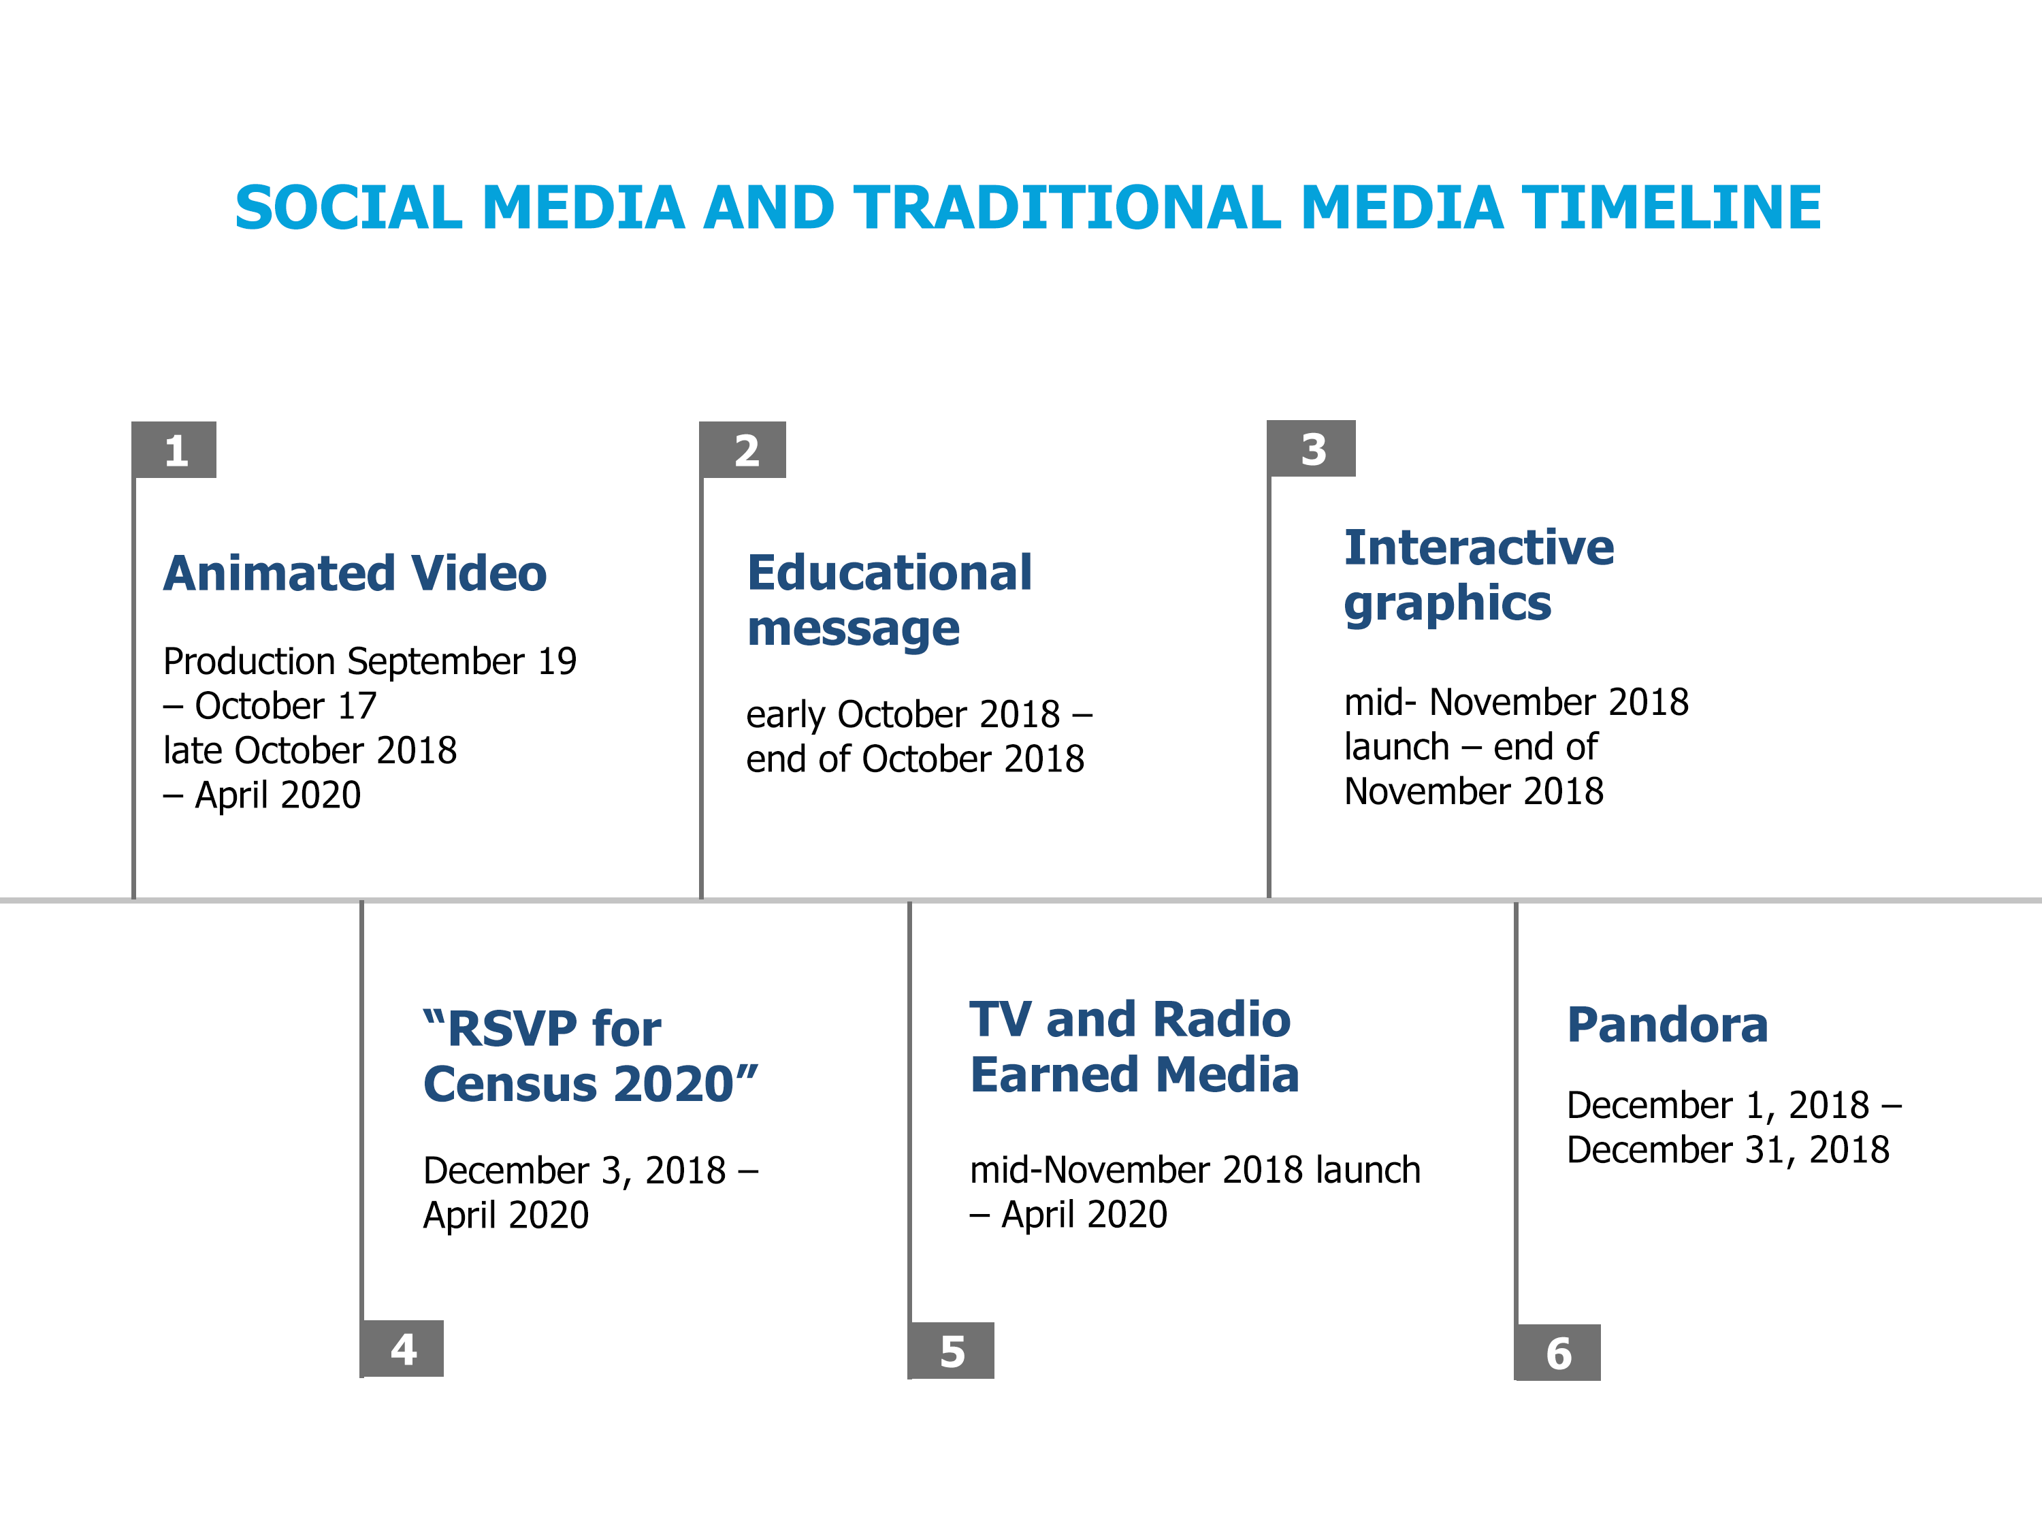

Slide 20
2020 CENSUS:
FUTURE RESEARCH PLAN & NEEDS
FUTURE RESEARCH & NEEDS
10-week Latino Voter Tracking Poll – NALEO Educational Fund and Latino Decisions are currently conducting a 10-week Latino Voter tracking poll; a census question will be added during one of the weeks
National Poll & Focus Groups - Conduct national poll and focus groups in 2019 to refresh messaging and inform GOTC campaign; research will begin after a final determination is made on the inclusion of a citizenship question
Test GOTC strategies to inform other civic engagement programs
As resources allow, Fill Research Gaps:
  Continue to understand the diverse Latino community; LGBTQ, Afro-Latino, Non-Spanish/Non-English dominant communities, Puerto Rico
  Understand best messages and motivators to mitigate the undercount of children 4 and under
  State and local specific research
Continue to be a resource to partner organizations to help inform their research

Slide 21
TAKE ACTION!
JOIN OUR CENSUS 2020 CAMPAIGN!
Visit www.NALEO.org/Census2020
#SaveTheCensus
Email to censusGOTC@naleo.org with “Subscribe” in the subject line to join our Census email list.
Text “CENSUS” to 97779 to join our SMS/Census Get Out the Count list.
(Standard messaging rates apply).

Slide 22

Thank you.
Arturo Vargas
Chief Executive Officer
avargas@naleo.org
Twitter: @ArturoNALEO
www.naleo.org

