Slide 1
AAPI Messaging Research on the 2020 Census

Slide 2
Research Objectives
Objective 1: Assess attitudes of and discover potential motivations for the target audience to participate in the 2020 Census.
Objective 2: Identify at least three key behavioral opportunities among the target audience to overcome barriers to participation in the 2020 Census.
Objective 3: Expose the target audience to conceptual media messaging to discover what will motivate the population to participate in the 2020 Census.

Slide 3
Research Phases
Ten focus groups in-language:
Chinese (Mandarin), South Asian (Urdu-speaking, Hindi-speaking), Korean, Southeast Asian (Cambodian, Vietnamese, Hmong), Mixed Asian Group (English – Chinese, Filipino, Korean, and Vietnamese)
Nearly 1,600 AAPI adults nationwide (citizens and non-citizens)
Oversample for Native Hawaiians and Pacific Islanders
English, Mandarin, Vietnamese, Korean, and Tagalog
Margin of error +/- 2.5%

Slide 4
Focus Group Findings
The Census
  The awareness about the U.S. Census in these groups is low. While some participants know what it is in theory, most did not know that the census is coming up in 2020
Citizenship Question
  All groups are concerned about the citizenship question and said they would be less likely to encourage other members of their community to fill out the census if the question was included
Advertising
  Overall, the response to advertisements developed for Asian communities from the 2010 Census Bureau campaign was positive, but there were some concerns of people being targeted

Slide 5
Messages Tested
Duty – participation in the Constitution
Resources – jobs, housing, education, etc.
Representation in elections
Understanding our needs in the community
Part of being American – appealing to tradition and democracy
Privacy – info kept confidential
Standing up against racism and discrimination to be counted
Visibility as AAPI community
Critical to family and children’s future
Helped in the past to increase resources
Protected by law

Slide 6

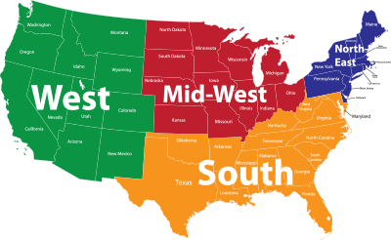
Demographic Profile
The survey reflects the diverse Asian American and Pacific Islander population in the country.
GENDER
AGE
EDUCATION
EMPLOYMENT STATUS
Under 30
23%
1-11th Grade
1%
Employed-
Full Time
42%
30-39
21%
HS Graduate
14%
40-49
20%
Some College
19%
Employed-
Part Time
13%
50-64
21%
Associate
11%
8%
47%
53%
College Grad
35%
Unemployed
65+
15%
Post-Grad
19%
Homemaker
12%
Student
8%
Ethnicity
REGION
Retired
16%
Chinese
21%
Indian
19%
Northeast
20%
Korean
10%
Japanese
5%
Pacific Islander/ Native Hawaiian
Midwest
12%
Filipino
17%
4%
South
24%
Vietnamese
10%
Other
14%
West
44%

Slide 7
A majority (55%) of AAPIs have not heard anything about the 2020 Census.
Knowledge of 2020 Census
Q10. Have you heard anything about the next U.S. Census taking place in 2020 or, like many people, have you not heard anything about that?

Slide 8
Knowledge of the 2020 Census is highest among Indian Americans and Korean Americans but still less than a majority, while it is lowest among Japanese Americans and Native Hawaiian and Pacific Islanders.
Knowledge of 2020 Census
Not Sure
9
11
6
11
6
11
7
6
7
Q10. Have you heard anything about the next U.S. Census taking place in 2020 or, like many people, have you not heard anything about that?

Slide 9
Knowledge of the upcoming census is highest among younger AAPIs and first or second generation immigrants.
Knowledge of 2020 Census
Not Sure
9
9
8
9
7
8
Q10. Have you heard anything about the next U.S. Census taking place in 2020 or, like many people, have you not heard anything about that?

Slide 10
Two in three (67%) AAPIs say they will almost certainly or probably participate in the next census, leaving one-third who are uncertain if they will participate.
Likelihood of Participating in the Next Census
33%
Q11. How likely would you say you are to participate in the next US Census?

Slide 11
Indian Americans, Chinese Americans, and Japanese Americans are most likely to say they will participate in the U.S. Census, while Native Hawaiians and other groups are less sure.
Initial Completion (%) | Total | Chinese | Indian | Filipino | Korean | Vietnamese | Japanese | Native Hawaiian & Pacific Islander | Other
Almost Certain | 44 | 46 | 47 | 38 | 43 | 37 | 46 | 35 | 53
Probably | 23 | 24 | 22 | 19 | 25 | 23 | 29 | 25 | 21
About 50-50 | 16 | 15 | 16 | 21 | 18 | 15 | 12 | 15 | 10
A Little Likely | 5 | 2 | 7 | 7 | 2 | 9 | 1 | 7 | 4
Not at All Likely | 3 | 1 | 2 | 4 | 5 | 6 | 3 | 8 | 4
Not Sure | 9 | 11 | 5 | 11 | 7 | 10 | 9 | 10 | 8
Darker colors indicate intensity.
Q11. How likely would you say you are to participate in the next US Census?

Slide 12
AAPI Americans say they are most likely to complete the census using the online option or by returning the paper form. Very few see themselves using the door-to-door option or the call-in number.
Preferred Method of Response
Very Likely to Use This Method
* Indicates split sample.
Q13. Below are four ways to respond to the US Census. Please rate each item on a scale from 1 to 5, where FIVE means you are very likely you would be to use that method to complete the US Census, and 1 means you are not at all likely to use that method to complete the US Census.

Slide 13
Vietnamese Americans are particularly responsive to the option of completing the census online in-language, while Native Hawaiians and Pacific Islander Americans, Indian Americans, and Korean Americans prefer the paper form.
Preferred Method of Response % Very Likely To Use | Total | Chinese | Indian | Filipino | Korean | Vietnamese | Japanese | Native Hawaiian & Pacific Islander | Other
A form that you can complete online on a smart phone or computer* | 52 | 57 | 46 | 53 | 48 | 46 | 68 | 47 | 56
A form that you can complete online in your language of choice on a smartphone or computer* | 52 | 52 | 56 | 48 | 50 | 62 | 45 | 45 | 53
A form mailed to you by the government (and does not require postage to return) | 52 | 46 | 58 | 51 | 53 | 40 | 49 | 62 | 58
The Census Bureau will hire people to go door to door and ask for information if they have not yet received a form from you | 17 | 12 | 26 | 16 | 25 | 19 | 9 | 17 | 12
Call into a toll-free telephone number and provide your answers over the phone to a live operator in your language of choice | 16 | 14 | 19 | 15 | 16 | 15 | 8 | 12 | 19
Call into a toll-free telephone number and provide your answers over the phone to a liver operator | 14 | 13 | 23 | 13 | 11 | 21 | 7 | 8 | 7
* Indicates split sample.
Q13. Below are four ways to respond to the US Census. Please rate each item on a scale from 1 to 5, where FIVE means you are very likely you would be to use that method to complete the US Census, and 1 means you are not at all likely to use that method to complete the US Census.

Slide 14
Two of the top three reasons for participating in the census include making sure that our communities get resources.
Reasons to Participate in the US Census
5/DK
8
10
13
11
11
10
11
12
14
11
15
Darker colors indicate intensity.
Q14. Below is a list of reasons to participate in the US Census. Please rate each reason on a scale from ZERO to TEN, where ZERO means it is not at all important reason for you, and TEN means it is a very important reason for you.
Notes:
The top three on this slide represent where 27% rated very favorable
Note: anyone rating a six on the scale was placed in very favorable

Slide 15
All three of the top reasons to participate in the census test well among different AAPI communities, particularly Filipinos and Native Hawaiian/Pacific Islanders.
Top Three Reasons to Participate in the US Census (% very important) | Total | Chinese | Indian | Filipino | Korean | Vietnamese | Japanese | Native Hawaiian & Pacific Islander | Other
The census makes sure our community gets its fair share of resources | 27 | 27 | 24 | 31 | 23 | 22 | 29 | 35 | 33
My community needs resources and government services | 27 | 25 | 18 | 31 | 22 | 21 | 30 | 36 | 41
It’s key to equality for all people here | 27 | 28 | 20 | 31 | 23 | 20 | 22 | 32 | 37
Q14. Below is a list of reasons to participate in the US Census. Please rate each reason on a scale from ZERO to TEN, where ZERO means it is not at all important reason for you, and TEN means it is a very important reason for you.

Slide 16
Among those who shift towards becoming more likely to complete the census after messaging, “my community needs resources and government services” rates highest.
Top Three Reasons to Participate in the US Census (% very important/10) | Total | Under 45 | 45+ | First Gen | Second Gen | Third+ Gen | Concerned About Citizenship Question | Not Concerned about Citizenship Question | Shift Towards Likely to Complete Census
The census makes sure our community gets its fair share of resources | 27 | 25 | 30 | 28 | 26 | 30 | 28 | 28 | 20
My community needs resources and government services | 27 | 24 | 31 | 26 | 27 | 32 | 28 | 26 | 22
It’s key to equality for all people here | 27 | 23 | 31 | 29 | 23 | 25 | 25 | 28 | 19
Q14. Below is a list of reasons to participate in the US Census. Please rate each reason on a scale from ZERO to TEN, where ZERO means it is not at all important reason for you, and TEN means it is a very important reason for you.

Slide 17
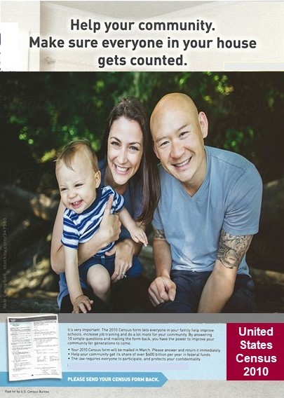
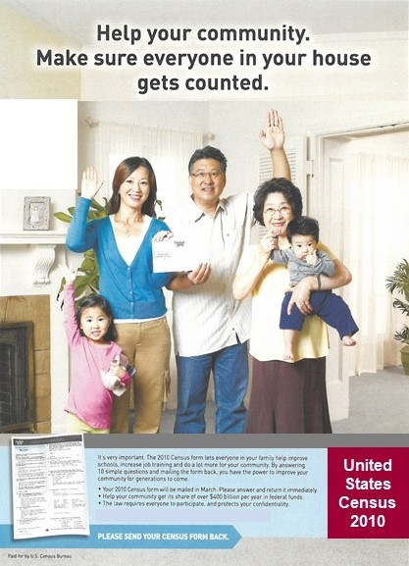
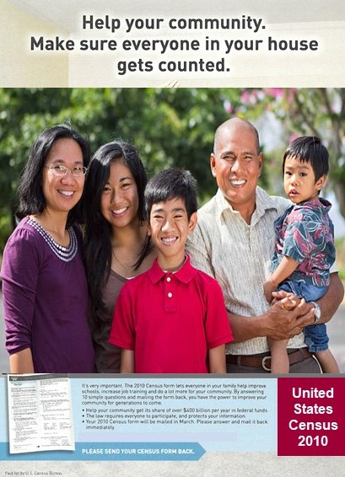
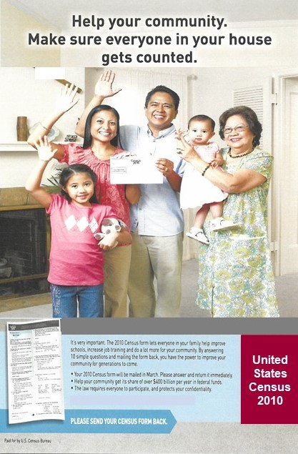
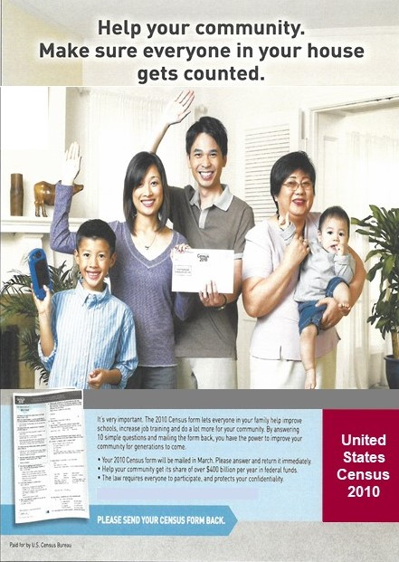
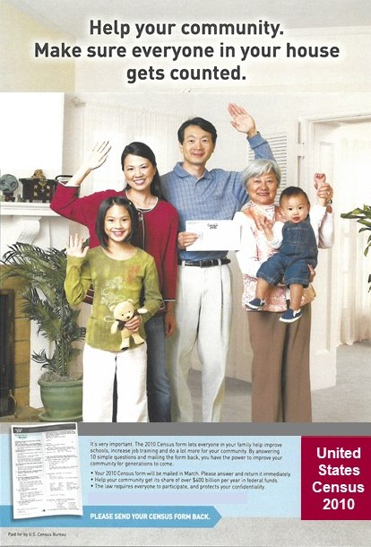
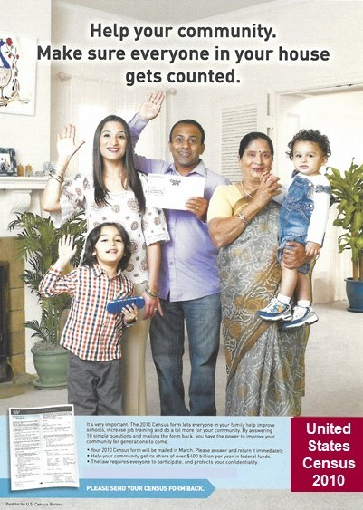
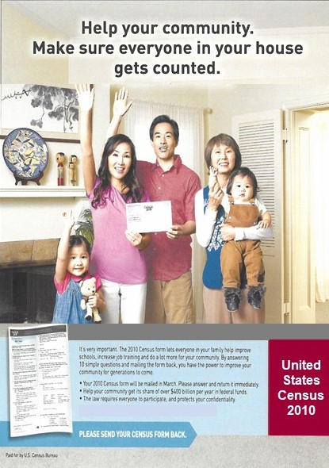
Responses to the tested advertisement were positive, with nearly 8 in 10 (79%) rating the advertisement as a convincing reason to participate in the census.
2010 US Census Advertisement
Darker colors indicate intensity.
Q15. Below is an image of an advertisement used in 2010 designed to encourage participation in the census. Please rate how convincing this advertisement would be for you to participate in the US Census on a scale from 0 to 10, where ZERO means it is a not at all convincing advertisement to participate in the US Census and TEN means it is a very convincing advertisement. [USE ADVERTISEMENT THAT MATCHES LANGUAGE OF SURVEY]

Slide 18
The advertisement was most intensely convincing (10 out of 10) to Indian, Filipino and Vietnamese Americans.
2010 US Census Advertisement
5/DK
11
13
6
12
11
12
19
14
9
Darker colors indicate intensity.
Q15. Below is an image of an advertisement used in 2010 designed to encourage participation in the census. Please rate how convincing this advertisement would be for you to participate in the US Census on a scale from 0 to 10, where ZERO means it is a not at all convincing advertisement to participate in the US Census and TEN means it is a very convincing advertisement. [USE ADVERTISEMENT THAT MATCHES LANGUAGE OF SURVEY]

Slide 19
The advertisement does slightly better among those who are concerned about the citizenship question.
2010 US Census Advertisement
5/DK
11
11
11
9
15
11
10
10
8
Darker colors indicate intensity.
Q15. Below is an image of an advertisement used in 2010 designed to encourage participation in the census. Please rate how convincing this advertisement would be for you to participate in the US Census on a scale from 0 to 10, where ZERO means it is a not at all convincing advertisement to participate in the US Census and TEN means it is a very convincing advertisement. [USE ADVERTISEMENT THAT MATCHES LANGUAGE OF SURVEY]

Slide 20
The Family message is particularly strong among Filipino Americans and ranks as one of the top two messages for all AAPIs.
% Very Convincing | Total | Chinese | Indian | Filipino | Korean | Vietnamese | Japanese | Native Hawaiian & Pacific Islander | Other
Family* | 42 | 43 | 42 | 48 | 33 | 34 | 41 | 42 | 44
Family – Children Focus* | 41 | 42 | 46 | 43 | 47 | 29 | 31 | 38 | 40
Resources* | 38 | 35 | 37 | 43 | 45 | 33 | 32 | 37 | 38
Helped in Past* | 38 | 35 | 41 | 38 | 37 | 35 | 35 | 42 | 41
*Messages split-sampled.
Q20. Below are some statements to encourage people to participate in the census. Please give each a rating on how convincing a reason to participate in the Census it is to you - very convincing, somewhat convincing, not too convincing, or not at all convincing {RANDOMIZE LIST}

Slide 21
Among those who move towards participation after messaging, the Children Focus message is the most effective, with nearly half (48%) saying it is a very convincing reason to participate in the U.S. Census.
% Very Convincing | Total | Under 45 | 45+ | First Gen | Second Gen | Third+ Gen | Concerned About Citizenship Question | Not Concerned about Citizenship Question | Shift Towards Likely to Complete Census
Family* | 42 | 38 | 45 | 44 | 36 | 40 | 46 | 39 | 38
Family – Children Focus* | 41 | 42 | 41 | 44 | 40 | 30 | 40 | 45 | 48
Resources* | 38 | 36 | 40 | 40 | 35 | 36 | 40 | 38 | 35
Helped in Past* | 38 | 37 | 39 | 38 | 38 | 42 | 43 | 36 | 36
*Messages split-sampled.
Q20. Below are some statements to encourage people to participate in the census. Please give each a rating on how convincing a reason to participate in the Census it is to you - very convincing, somewhat convincing, not too convincing, or not at all convincing {RANDOMIZE LIST}

Slide 22
The top message for communicating the importance of the census is Family, which is very convincing for 42% of AAPIs, followed by the version which has a Children Focus.
Top Tier Messages (Ranked by Very Convincing) | Very Convincing | Total Convincing
[FAMILY*] Census data is critical to our families' future and the next generation. It helps us get the health care, transportation, schools, affordable housing, and higher education that our families need to get a good start and be successful. | 42 | 79
[FAMILY – CHILDREN FOCUS*] Census data is critical to our children’s future and the next generation. It helps us get the health care, transportation, schools, affordable housing, and higher education that our children need to get a good start and be successful. | 41 | 81
[RESOURCES*] Census data is used to determine not only federal government funding for programs and services, but businesses also use it to decide where to invest and create jobs. Filling out the census makes sure that you, your family, and your community get a fair shot at those resources. | 38 | 78
[HELPED IN PAST*] The 2010 census showed that in one major city, the Asian American community had doubled in the previous ten years. This led to a 50 million dollar increase in federal dollars for schools, hospitals, and services for our kids. Filling out the census can have real benefits for our community. | 38 | 76
*Messages split-sampled.
Q20. Below are some statements to encourage people to participate in the census. Please give each a rating on how convincing a reason to participate in the Census it is to you - very convincing, somewhat convincing, not too convincing, or not at all convincing {RANDOMIZE LIST}

Slide 23
Across the board, the best way to deliver this advertisement for AAPIs is to mail it to their homes. Online ads are helpful to reach those who become more likely to participate after messages.
Means or Placement of Advertising (% Rate 5) | Total | Under 45 | 45+ | First Gen | Second Gen | Third+ Gen | Concerned About Citizenship Question | Not Concerned about Citizenship Question | Shift Towards Likely to Complete Census
Mailed to your house | 45 | 38 | 53 | 46 | 41 | 47 | 43 | 49 | 37
Television advertisement | 36 | 30 | 42 | 39 | 29 | 38 | 42 | 31 | 31
Online advertisement | 28 | 31 | 25 | 30 | 24 | 29 | 35 | 23 | 33
Placed in a community center | 27 | 28 | 26 | 29 | 24 | 25 | 33 | 22 | 26
Advertisement in a major metropolitan area | 26 | 24 | 29 | 28 | 23 | 27 | 32 | 22 | 19
Billboard | 25 | 25 | 26 | 27 | 23 | 25 | 31 | 22 | 28
Advertisement in an ethnic newspaper | 24 | 23 | 25 | 24 | 24 | 21 | 29 | 19 | 20
Placed in a local business shop | 24 | 26 | 22 | 24 | 23 | 29 | 28 | 21 | 24
Placed in a house of worship | 20 | 20 | 19 | 19 | 19 | 25 | 24 | 16 | 15
Q18. Below are places where an advertisement could be displayed that would encourage your participation in your census. Please rate each item, on a scale from 1 to 5, where FIVE means it is very likely to encourage your participation in the US Census, and ONE means that it is not at all likely to encourage participation in the US Census.

Slide 24
Mail advertising is the most likely to encourage participation in the census across most AAPI communities. Indian Americans rate television advertisements slightly higher.
Means or Placement of Advertising (% Rate 5) | Total | Chinese | Indian | Filipino | Korean | Vietnamese | Japanese | Native Hawaiian & Pacific Islander | Other
Mailed to your house | 45 | 41 | 43 | 47 | 40 | 41 | 45 | 43 | 56
Television advertisement | 36 | 24 | 45 | 38 | 33 | 33 | 27 | 39 | 44
Online advertisement | 28 | 13 | 40 | 32 | 27 | 34 | 15 | 31 | 29
Placed in a community center | 27 | 18 | 34 | 32 | 20 | 34 | 14 | 29 | 29
Advertisement in a major metropolitan area | 26 | 20 | 31 | 28 | 27 | 27 | 21 | 31 | 27
Billboard | 25 | 19 | 33 | 28 | 20 | 30 | 14 | 30 | 26
Advertisement in an ethnic newspaper | 24 | 20 | 31 | 23 | 24 | 21 | 14 | 26 | 23
Placed in a local business shop | 24 | 18 | 28 | 31 | 21 | 25 | 13 | 29 | 23
Placed in a house of worship | 20 | 12 | 21 | 24 | 17 | 19 | 10 | 19 | 30
Q18. Below are places where an advertisement could be displayed that would encourage your participation in your census. Please rate each item, on a scale from 1 to 5, where FIVE means it is very likely to encourage your participation in the US Census, and ONE means that it is not at all likely to encourage participation in the US Census.

Slide 25
The top medium through which to encourage census participation among AAPI Americans is by mailing information to people’s homes, followed by television advertisements.
Means or Placement of Advertising
Very Likely to Encourage Participation
Q18. Below are places where an advertisement could be displayed that would encourage your participation in your census. Please rate each item, on a scale from 1 to 5, where FIVE means it is very likely to encourage your participation in the US Census, and ONE means that it is not at all likely to encourage participation in the US Census.

Slide 26
Nearly half (48%) of AAPI Americans are concerned about the addition of the citizenship question, indicating a potentially serious impact on participation.
Concern in Regards to the Addition of the Citizenship Question
Darker colors indicate intensity.
Q25. Regardless of whether you have heard of it or not, how concerning would a question on the US Census asking if you are a citizen or not be?

Slide 27
Concern about the citizenship question is highest among Korean and Indian Americans.
Concern About Citizenship Question
Not Sure
6
6
4
5
7
7
12
10
6
Darker colors indicate intensity.
Q25. Regardless of whether you have heard of it or not, how concerning would a question on the US Census asking if you are a citizen or not be?

Slide 28
Interestingly, concern about the citizenship question is higher among third generation and beyond AAPIs.
Concern About Citizenship Question
Not Sure
6
8
4
5
8
6
Darker colors indicate intensity.
Q25. Regardless of whether you have heard of it or not, how concerning would a question on the US Census asking if you are a citizen or not be?

Slide 29
Those who are concerned about the citizenship question and those who become more likely to complete the census after messaging are more likely to use the mail-in option to complete the census.
Preferred Method of Response % Very Likely To Use | Total | Under 45 | 45+ | First Gen | Second Gen | Third+ Gen | Concerned About Citizenship Question | Not Concerned about Citizenship Question | Shift Towards Likely to Complete Census
A form that you can complete online on a smart phone or computer* | 52 | 41 | 66 | 54 | 47 | 60 | 52 | 55 | 42
A form that you can complete online in your language of choice on a smartphone or computer* | 52 | 59 | 44 | 53 | 54 | 48 | 51 | 55 | 50
A form mailed to you by the government (and does not require postage to return) | 52 | 51 | 52 | 52 | 51 | 55 | 55 | 52 | 57
The Census Bureau will hire people to go door to door and ask for information if they have not yet received a form from you | 17 | 17 | 18 | 19 | 14 | 18 | 22 | 15 | 17
Call into a toll-free telephone number and provide your answers over the phone to a live operator in your language of choice | 16 | 15 | 16 | 17 | 13 | 20 | 23 | 10 | 19
Call into a toll-free telephone number and provide your answers over the phone to a liver operator | 14 | 15 | 13 | 15 | 13 | 14 | 19 | 10 | 14
* Indicates split sample.
Q13. Below are four ways to respond to the US Census. Please rate each item on a scale from 1 to 5, where FIVE means you are very likely you would be to use that method to complete the US Census, and 1 means you are not at all likely to use that method to complete the US Census.

Slide 30
After hearing messages encouraging participation in the census, by the end of the survey, nearly 3 in 4 (73%) of Asian Americans say they probably or certainly will participate in the next U.S. Census.
Final Likelihood of Participation in Next Census
27%
Q26. Sometimes in a survey like this, people change their minds. Once more, how likely would you say you are to participate in the next US Census if the citizenship question is on the census form?

Slide 31
Messaging helps us make modest gains across the board in participation, with more AAPIs likely to say they are almost certain or probably certain they will participate in the next census.
Initial to Final Likelihood of Participating in Next Census
Q11. How likely would you say you are to participate in the next US Census?
Q26. Sometimes in a survey like this, people change their minds. Once more, how likely would you say you are to participate in the next US Census if the citizenship question is on the census form?

Slide 32
Shift Towards Likely to Participate – 13% of AAPIs
After messaging, those who shift towards participation are more likely to be women, under 45, and Filipino Americans or Vietnamese Americans.
Profile of Those Who Shift Towards Likely To Participate in US Census
 | % of Shifters | % of All
Men | 28 | 47
Women | 72 | 53
Under 45 | 66 | 54
45 and Over | 34 | 46
Northeast | 12 | 20
Midwest | 11 | 12
South | 29 | 24
West | 48 | 44
Profile of Those Who Shift Towards Likely To Participate in US Census
 | % of Shifters | % of All
Chinese | 17 | 21
Indian | 21 | 19
Filipino | 22 | 17
Vietnamese | 14 | 10
Korean | 10 | 10
Japanese | 4 | 5
Native Hawaiian/ Pacific Islander | 5 | 4
Other Asians | 7 | 14

Slide 33
Shift Towards Not Likely to Participate– 12% of AAPIs
Underscoring the importance of communicating with women and AAPIs under 45, those are the groups who also shift towards not participating in the Census. Chinese Americans are also more likely to move towards being less likely to participate in the census.
Profile of Those Who Shift Towards Not Likely To Participate in US Census
 | % Of Shifters | % of All
Men | 35 | 47
Women | 65 | 53
Under 45 | 67 | 54
45 and Over | 33 | 46
Northeast | 27 | 20
Midwest | 8 | 12
South | 16 | 24
West | 49 | 44
Profile of Those Who Shift Towards Not Likely To Participate in US Census
 | % of Shifters | % of All
Chinese | 28 | 21
Indian | 14 | 19
Filipino | 17 | 17
Vietnamese | 12 | 10
Korean | 9 | 10
Japanese | 3 | 5
Native Hawaiian/ Pacific Islander | 4 | 4
Other Asians | 12 | 14

Slide 34

The Takeaways
A majority of AAPIs have not heard anything about the upcoming census, and only 2/3 say they would be likely to participate.
AAPIs strongly prefer the paper form and online options to the phone or in-person options, with those concerned about the citizenship question more likely to use the paper option.
Our messaging should highlight that the census helps your community get its fair share of resources and government services, that it is key to equality, and that completing the census will help your family.

Slide 35
The Takeaways
AAPIs rate the advertisements as a convincing reason to participate and would like to see the advertisement mailed to their houses.
More than one in three (34%) AAPIs give a great deal of attention to friends and family as a source of information about the US Census.
  While Friends and Family rates highest among those under 45 years old (40% great deal of attention), those 45 and over narrowly rate English language news media (32%) higher than friends and family (28%).
  For women particularly, communicating through children’s schools (30%) may be an effective avenue, the second best testing item for that group after Friends and family (36%).
Communicating with AAPIs, particularly women and those under 45, is important to ensuring fair and accurate representation in 2020.

Slide 36
John C. Yang, President and Executive Director jcyang@advancingjustice-aajc.org
QUESTIONS?

